Slide 1

Enhanced Drowsiness Detection
ROHINI B
VARUN RAAJ S M
SHIVA RAMALINGAM V
VASANTHA RUBAN N
Oct 22 2023
Team Name: Team ZEEZ

Slide 2
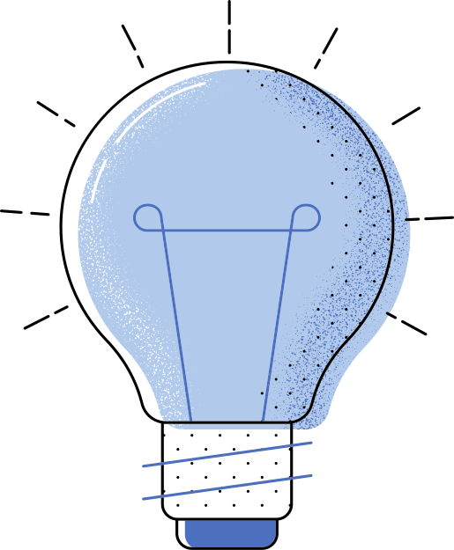

MEETING AGENDA
01
02
PROJECT OVERVIEW
TECH STACK
03
04
SOFTWARE USED
PROJECT ARCHITECTURE

Slide 3
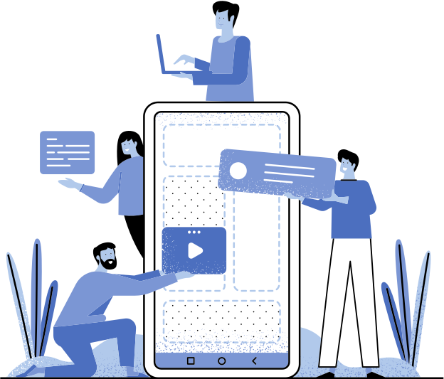
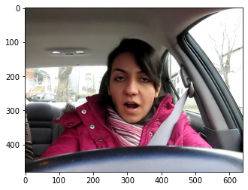
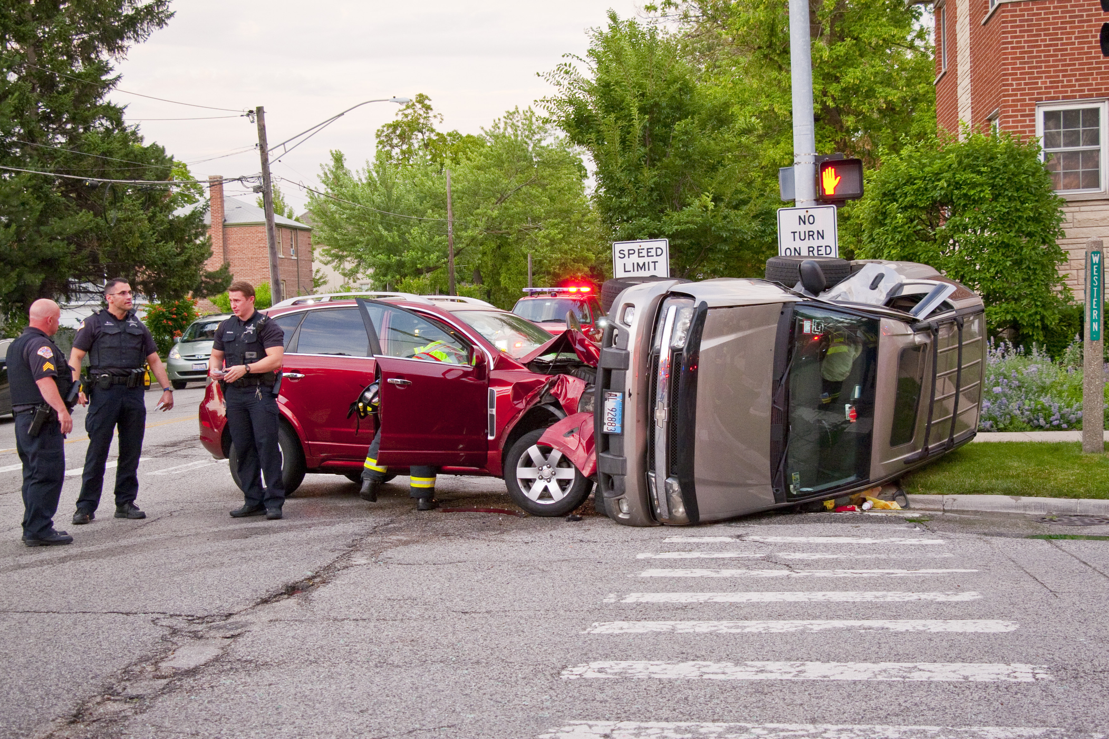
PROJECT OVERVIEW
To Detect the Drowsiness While Driving, and
Alert the driver and surrounding.

Slide 4
TECH STACK
Dlib
OpenCV
Python
NumPY

Slide 5
SOFTWARES USED
Google Colab
Python IDE
Git & Github

Slide 6
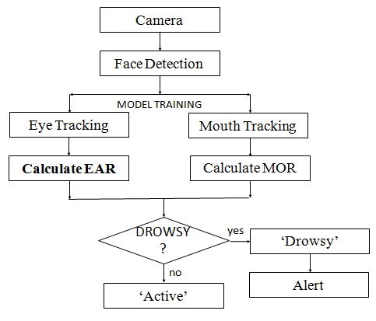
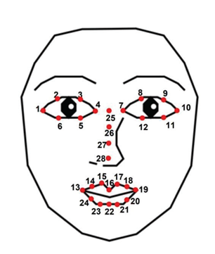
PROJECT ARCHITECTURE

Slide 7
PROJECT ARCHITECTURE
Alert Mechanism
Seat Belt Vibration
Stimulus Provider
Alarm Inside and Outside the Car
Light Indication If Slept

Slide 8
SPECIFICATIONS
Vibration Motor Specification
Motor Type : ERM Vibration Motor
Motor Vibration Frequency : 100Hz

Slide 9
Resources
1.
https://pubs.aip.org/asa/jasa/article-abstract/141/5/3262/606256/Physiological-effects-of-railway-vibration-and?redirectedFrom=fulltext .
2. https://www.sciencedirect.com/science/article/abs/pii/S0022437522000275 .
3. https://ieeexplore.ieee.org/abstract/document/8289328 .

Slide 10

THANK YOU

